Slide 1

CSC-40038
Collaborative Application Development
(CAD)
Presented by : Team 4
Team members : Abby Kapambwe, Alan Crossley, Nachiket Saggam, Rory Gee & Sangeeth Sarangi

Slide 2
DATA ANALYSIS

Slide 3
Contents
The Purpose
Questions
Analysis on Data
Conclusion

Slide 4
THE PURPOSE
Our objective is to answer the questions that the conference organisers are seeking as well the questions we derived during the observations and there by help to determine the trends and relationships among the variables

Slide 5
QUESTIONS
What is the impact of preregistration?
How many delegates registered and attended?
How long did virtual delegates attend for the stand ?
How long did virtual delegates attend ?
Did anyone attend in-person and then log on later to view the information and or network?
When did delegates attend?
Which sessions were popular and why?
How satisfied were user with events?
How did the delegates use the website?
How was the online engagement before and after the conference?
How many exhibition stands were visited, for how long?
How many and what type of questions asked of the speakers by virtual attendees?

Slide 6
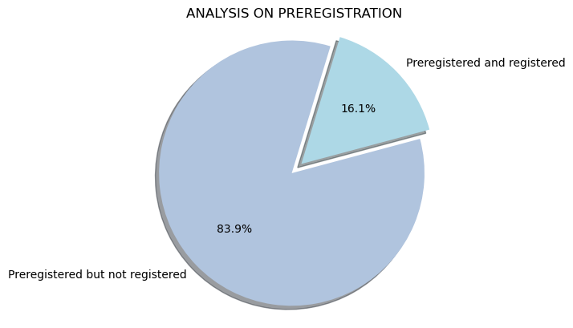
1. What is the impact of preregistration?
From the data, we found that more than 80% of the people who are doing a preregistration of the event are not at all registering the event later
Only less than 20% of people are coming later
Attendees might have preregistered when they got the mail invite, but later forget to attend the event. We need to avoid this by increasing the visibility of the event, by sending gentle reminder mails ,colourful brochures of the event and if possible announcements via social media.

Slide 7
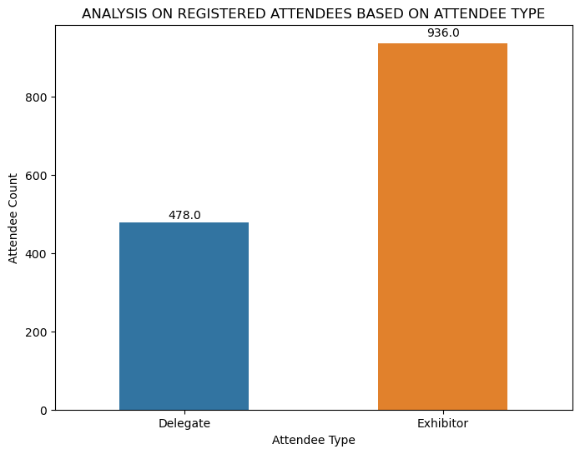
2. How many delegates registered and attended?
We observed that 1428 attendees registered for the various events.
Out of this 1428, 478 people are Delegates and 936 people are Exhibitors
From the bar graph, it’s evident that delegate’s count is around 50% of the exhibitor’s count

Slide 8
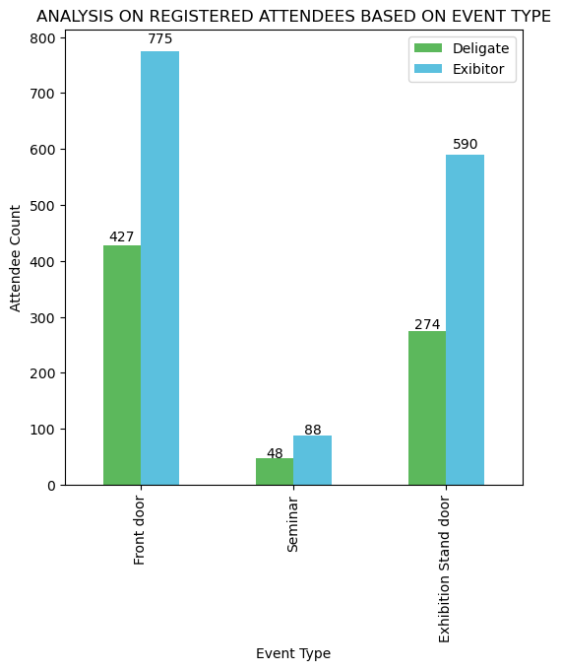
Here we are going to analyze the registered attendees based on the event type.
So, we could see most of the attendees preferred front door event.
In case of virtual attendees, we could see a total of 132 attendees registered for Seminar and in this 48 attendees were delegates and 88 were exhibitors.
For exhibition stand door event,274 delegates were registered
In every event type, could see delegate’s count is around 50% of the exhibitor’s count.

Slide 9
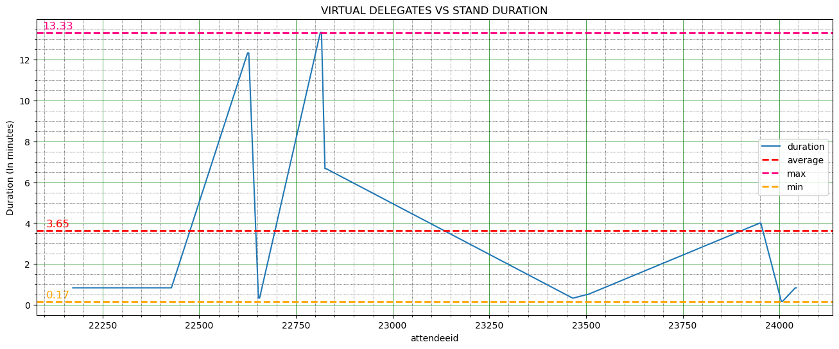
3. How long did virtual delegates attend for the stand ?
From the line graph, we could observe virtual delegates spend an average of 3.65 minutes on stand
Maximum time spend on the stand is 13.33 minutes whereas minimum time spend is 0.17 minutes

Slide 10
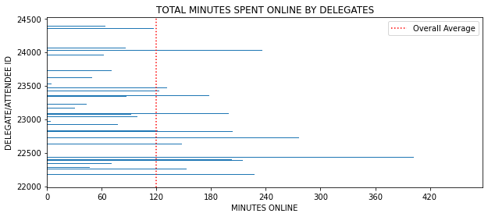
4. How long did virtual delegates attend?
The average attendance time for virtual delegates was two hours
This combines users time spent in sessions as well as at virtual stands
More accurate viewing times could be captured with ‘session time’ function

Slide 11
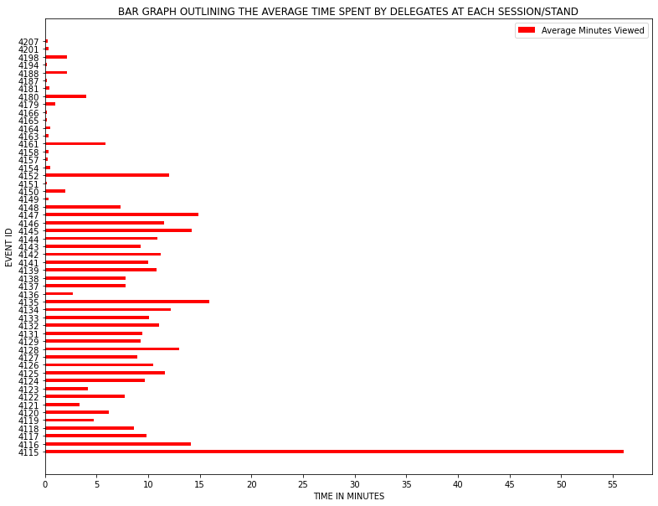
Highlights that Plenary Session (Event 4115) clearly had highest average which is to be expected.
AdEPT (Main Sponsor), Securing the Path for Digital Transformation, in top five highest average viewing times (around 14 minutes)
Other main sponsors, Oracle and Auth0 had average session viewing times below 10 minutes

Slide 12
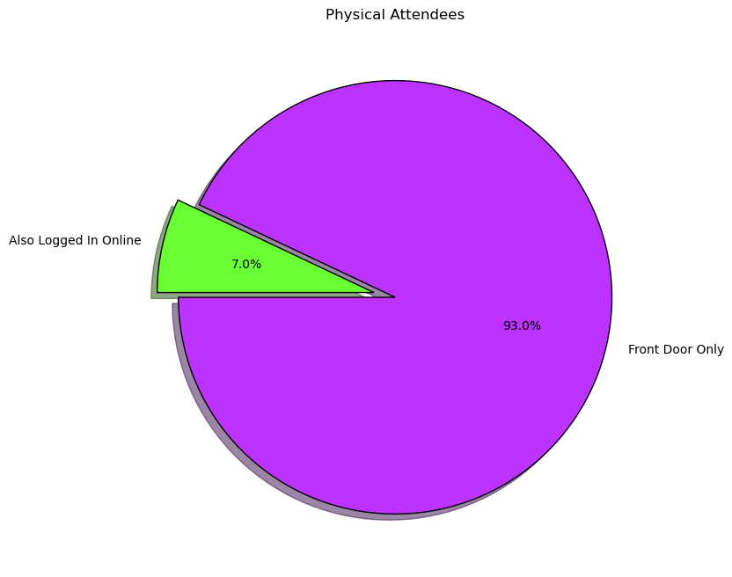
5. Did anyone attend-in-person and then log on later to view the information and or network?
Only 7% of those attending in-person later viewed the online information (30 delegates)
Further information could be sought from those who have not logged into the online platform as to the reasons why.
Potentially use a follow up questionnaire to capture information about networking successes, for example, whether they gained any leads and whether these were followed up.

Slide 13
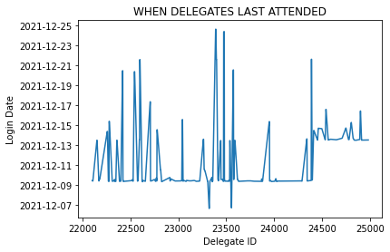
6. When did delegates attend?
The above visualises the last attendance of delegates based on the last login. The graph on the x axis shows the IDs in a range and the login dates on the y axis. From this graph we can tell the last attendance by observing the dates.
In the current dataset last attendance was on 25th December 2021.

Slide 14
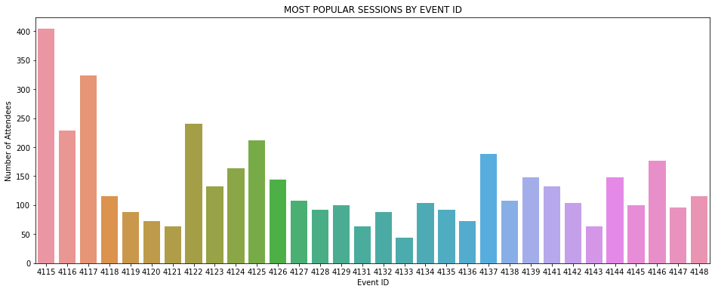
7. Which sessions were popular and why?
The chart visualises the most popular event by displaying the event with the most attendance. In this case the most popular event is shown by bar chart with more attendees.
In the current case the most popular session is one identified by event ID: 4115.
Recommendation : To determine the popular event and why, the system should have a table to record attendees feedback on particular sessions such as likes, or comments or ratings.

Slide 15
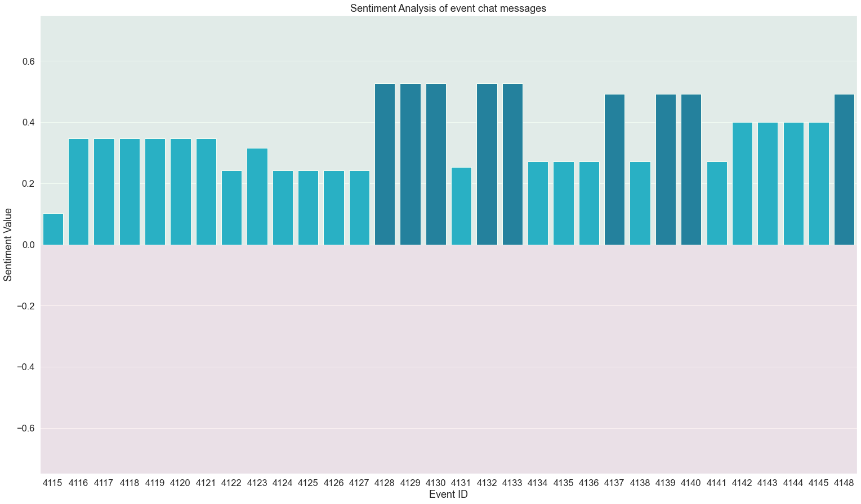
8. How satisfied were user with events? (Sentiment analysis)
Sentiment analysis of chat messages
Range is -1 to 1. Values above zero denote positive response.
No events have any negative response
But no events scored above 0.5
Events at beginning scored lower, maybe due to delay in starting.

Slide 16
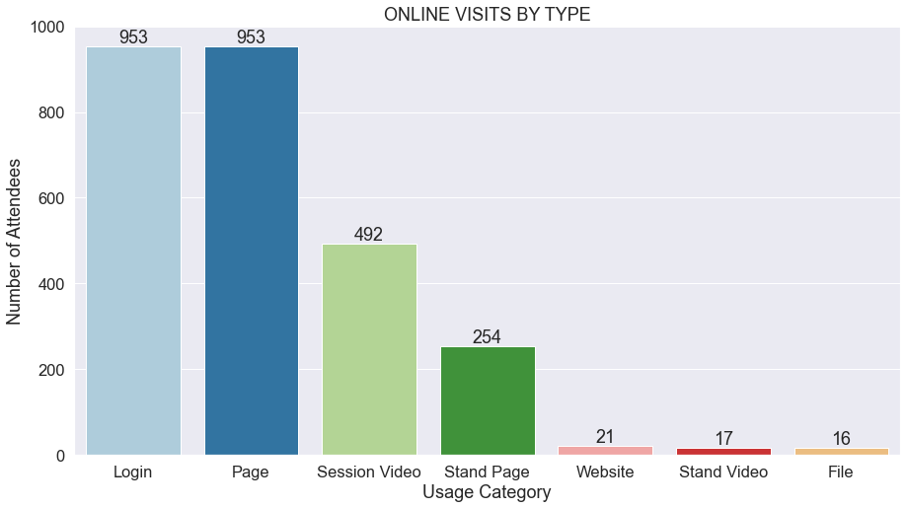
9. How did the delegates use the website?
Categorization of attendee log into respective reference types
About half of total online visitors were there for reasons other watching session videos possibly networking.
Of users watching sessions online (492) nearly half of them (254), also visited the stand pages
Small number of visitors also went to external links
Suggestion: Splitting Page ‘RefType’ into ore specific categories would help.

Slide 17
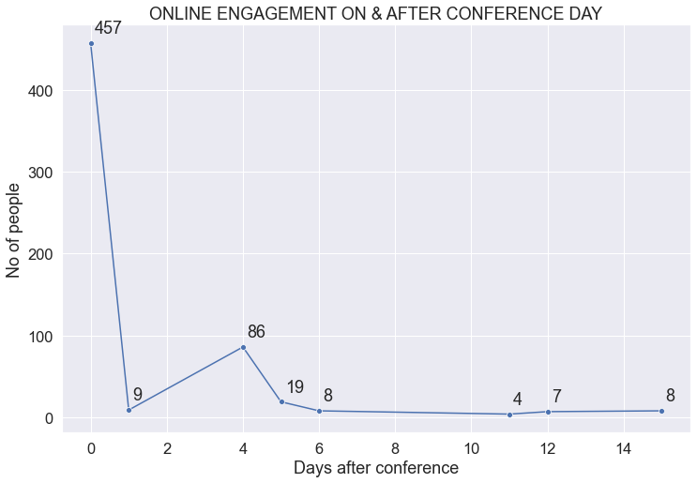
10.1 How was the online engagement after the conference?
Here we are tracking number of unique visitors for each day after conference
X axis is for number of days after conference
Users visited website up to 15 days after conference
0 location is the day of conference
Some rise in visitors on 4th day and again decrease

Slide 18
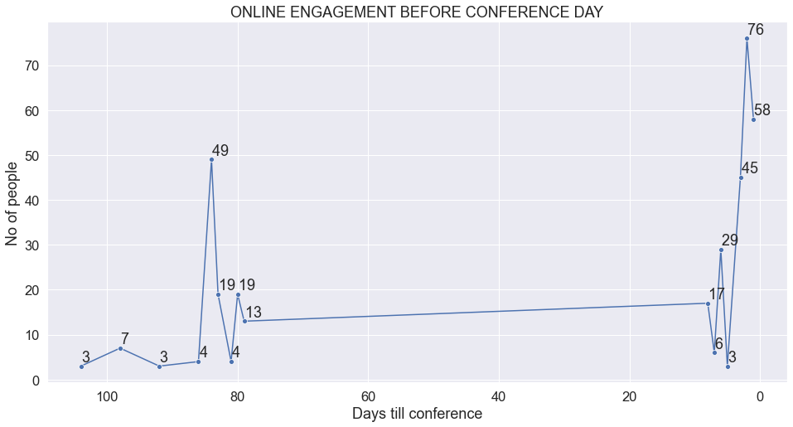
10.2 How was the online engagement before the conference?
Here we are tracking number of unique visitors for each day of conference
X axis is for number of days before conference
Users engaged with website up to 105 days before the conference
Bulk of visits happened between ranges of 90 -80 and 10-0 days before conference

Slide 19
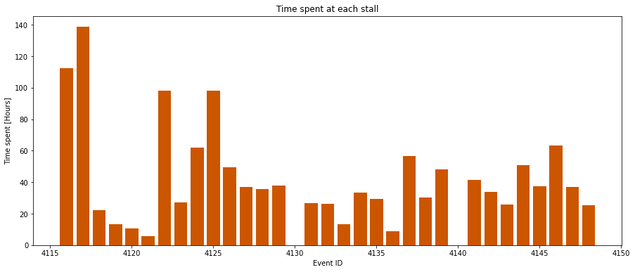
11. How many exhibition stands were visited, for how long?
Graph shows the total amount time spent on each stall in hours
The first event was an easily identifiable outlier, so was omitted from this visualisation.
Largest variation in time is due to select stands having a significantly higher proportion of traffic.

Slide 20
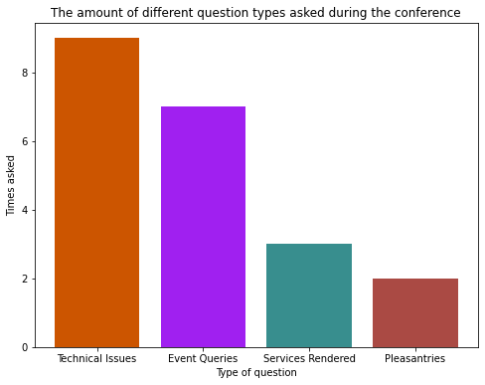
12. How many and what type of questions asked of the speakers by virtual attendees?
Questions were manually parsed due to a lack of functionality provided by readily available tools.
The graph here displays the number of each question asked by the attendees.
Two repeated (identical and sent at the same time) questions occurred and was omitted from the visualisation
Most common questions pertained to technical issues with the stream.

Slide 21
CONCLUSION
In conclusion, by answering the questions that the conference organisers are seeking we found some trends and relationships among the variables in the data
Based on the trend, for better participation, we must focus more on event reminders.
Events were generally successful from sentiment perspective, but we all felt that feedback data is one of the major missing data. If we have those data we can perform strong sentimental analysis on them, because the feedback data contains strong positive and negative words and there by we can measure user satisfaction

Slide 22
Thank You

